Slide 1


Speech Emotion Recognition using Machine Learning
This presentation explores the exciting world of speech emotion recognition (SER) and how machine learning is revolutionizing the way we understand human emotions.
Soumya Karuturi-AP22110010175
Jyotika Tammineedi- AP22110010457
Indra Narayana- AP22110010448
Guided by:
Dr. Murali Krishna Enduri

Slide 2
Problem Statement and Objectives
Problem
Objectives
SER seeks to accurately interpret emotional nuances in speech but faces challenges from accents, background noise, and speaking styles. These issues hinder emotion detection and limit applications like mental health diagnosis.
The main goal is to create accurate and robust SER systems that work reliably in real-world conditions, handling diverse emotions, accents, speaking styles, and noise. Efficiency and real-time performance are key priorities.

Slide 3
Introduction to Speech Emotion Recognition
What is SER?
How it works:
Importance of SER
Speech emotion recognition (SER) is the process of automatically identifying and classifying emotions expressed through speech.This provides a comprehensive understanding of communication.
SER systems employ a sophisticated process. First, they analyze acoustic features (such as pitch, intensity, tempo, pauses) then use Advanced signal processing techniques and machine learning algorithms to extract features and to train the datasets of labeled speech and classify them to detect the emotion which range from happiness, sadness, anger, fear, etc.
SER has numerous applications across various fields, it enchanes the understanding of an emotion in a speech more accurately. In human-computer interaction, SER can make interactions with machines more naturally by enabling computers to respond to human emotions. Moreover by recognizing emotions system can personalize interactions.

Slide 4
Understanding Speech Emotions
The Complexity of Human Emotion
Acoustic Cues for Emotion Detection
Humans express a wide range of emotions like happiness, sadness, anger, fear, surprise, and disgust through speech, often in complex and blended ways, making identification challenging.
Several acoustic features help us distinguish emotions. Pitch variation (higher, lower), intensity (louder, softer ), rhythm (faster, slower), and the presence of pauses all contribute to the emotional expression.
Challenges in Real-World Applications
Recognizing speech emotions is challenging due to variations in speaking styles, accents, noise, and the ambiguity of emotions, requiring accurate and adaptable SER systems.

Slide 5
System Workflow
Data Collection
SER systems require large, diverse speech datasets for effective training. These datasets must be carefully curated and labeled with accurate emotion annotations, accounting for variations in speech styles, accents, and noise levels. The quality and quantity of the data directly impact the model's performance and generalization capabilities.
Data Cleaning and Preprocessing
Raw audio data often contains noise and artifacts that can negatively affect the accuracy of emotion recognition. Preprocessing steps are crucial for removing irrelevant background sounds, normalizing speech intensity, and segmenting the audio into meaningful units. This often involves techniques like noise reduction filters, silence trimming, and voice activity detection.
Feature Extraction
Relevant acoustic features are extracted from the preprocessed audio to represent the emotional content. These features capture various aspects of the speech signal, such as pitch, intensity, rhythm, spectral characteristics, and formants. Careful selection of features is important to minimizing computational complexity. Common feature extraction techniques include Mel-Frequency Cepstral Coefficients (MFCCs), Linear Predictive Coding (LPC), and Prosodic features.

Slide 6
Feature Selection
The extracted features are often high-dimensional and may contain redundant or irrelevant information. Feature selection techniques are used to identify the most discriminative subset of features that can improve model performance and reduce computational costs. This might involve filter methods (e.g., correlation analysis), wrapper methods (e.g., recursive feature elimination), or embedded methods (e.g., L1 regularization).
Model Training and Selection
Various machine learning models are used for emotion classification, like Support Vector Machines (SVMs), Deep Neural Networks (DNNs) and Recurrent Neural Networks (RNNs). Each model has its strengths and weaknesses, and selecting the optimal model depends on the dataset, features, and desired performance. The model is trained on part of the labeled data to learn how features relate to emotions.
Model Validation and Tuning
The trained model is tested on a separate dataset to check how well it works on new, unseen data. The model's settings (hyperparameters) are adjusted to improve its accuracy, precision, recall, and F1-score. This process helps ensure the model can correctly identify emotions in different speech samples.
Model Testing and Evaluation
The model is tested on a separate dataset to evaluate its performance. Metrics are analyzed to understand its strengths, weaknesses, and areas for improvement.

Slide 7



Challenges and Limitations
Data Bias
1
Data imbalances and cultural variations can affect model accuracy and generalization.
Noise and Artifacts
2
Real-world noise and variations in speech recordings pose challenges for accurate emotion detection.
Subjectivity of Emotions
3
Emotions are subjective, making it difficult to define clear boundaries and universally accepted labels.

Slide 8
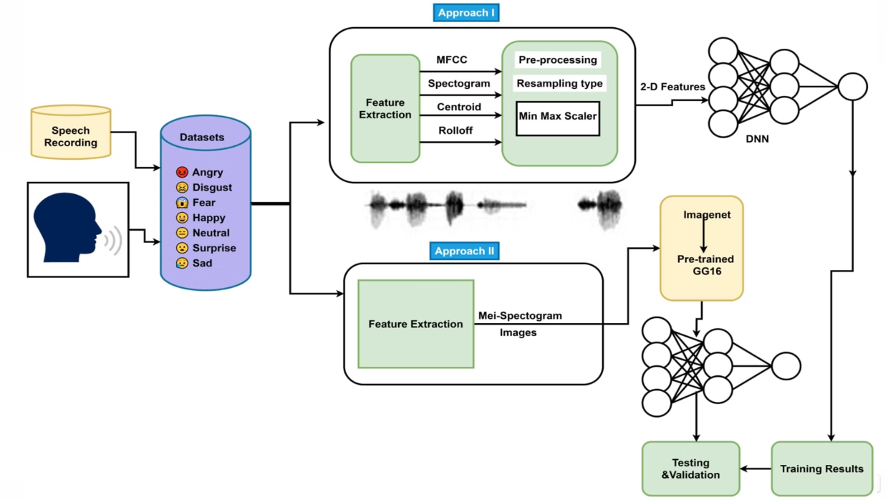
Methodology
Block Diagram:

Slide 9

Applications and Use Cases
1
2
Mental Health
Customer Service
SER can aid in diagnosing and monitoring mental health conditions, like depression and anxiety.
Analyzing customer calls can provide valuable insights into satisfaction and identify areas for improvement.
3
4
Education
Automotive Safety
SER can personalize learning experiences by detecting student emotions and adjusting teaching strategies accordingly.
Detecting driver drowsiness or distress can enhance safety measures in vehicles.

Slide 10
Results
Accuracy Metrics - 97.59%
1
Achieved an overall accuracy of 97.59% in classifying seven distinct emotions using the TESS dataset.
2
Confusion Matrix
Provided detailed insights into the model's performance in classifying emotions.
Performance Measures
3
Evaluated the model's precision, recall, F1 score, and other key performance indicators.
4
Successes
Demonstrated the model's high accuracy in emotion classification, showcasing its effectiveness.

Slide 11
Conclusion
The Speech Emotion Recognition (SER) system leverages LSTM networks to analyze audio signals and classify emotions such as happiness, sadness, and anger. By utilizing MFCC for feature extraction and employing data augmentation techniques, the system achieved a notable test accuracy of 97.59%, demonstrating its effectiveness in capturing temporal patterns within audio data.
This advancement holds significant potential for applications in mental health monitoring, virtual assistants, and multimedia analysis, enhancing human-computer interaction.
Future enhancements could include using larger and more diverse datasets, integrating advanced architectures like CNN-LSTM, and expanding the range of detectable emotions to cover more nuanced affective states.
It broadens the scope by expanding detectable emotions, integrating multimodal inputs (e.g., facial expressions), enabling real-time processing, and ensuring cross-cultural applicability are key areas for future research.

Slide 12
Thank You
We appreciate your time.

